Slide 1

Integrated framework for visualizing, and analyzing WSIs:
Summer Internship Summary
Abhinav Agarwalla
Department of Mathematics, IIT Kharagpur
Research Intern, Tissue Image Analytics (TIA) Lab
Department of Computer Science, University of Warwick
7th July 2017

Slide 2
Outline
GUI Functionalities
Visualization Aspects
Training, Testing DL models
Tensorboard Visualization
Tumor Segmentation
Modelling context using LSTMs
Problem, Approach, and Results

Slide 3
Visualization Aspects
Loading WSIs of various formats: TIF, JP2, NDPI + OpenSlide supported formats
Pan, Zoom, Random seek functionality
Simultaneous overlay of various types
Heatmap, Segmentation Mask, Nuclei Positions, Tumor Regions, etc.

Slide 4
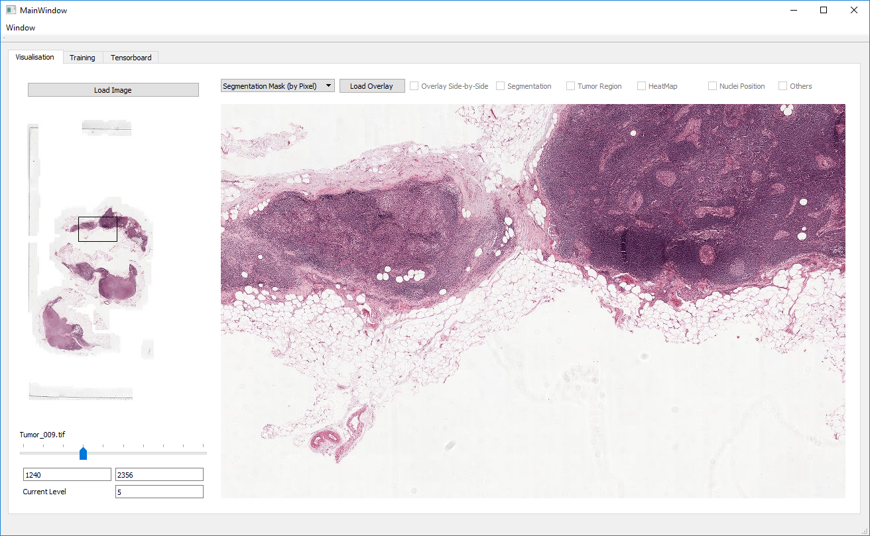
Interface- Visualisation Tab

Slide 5
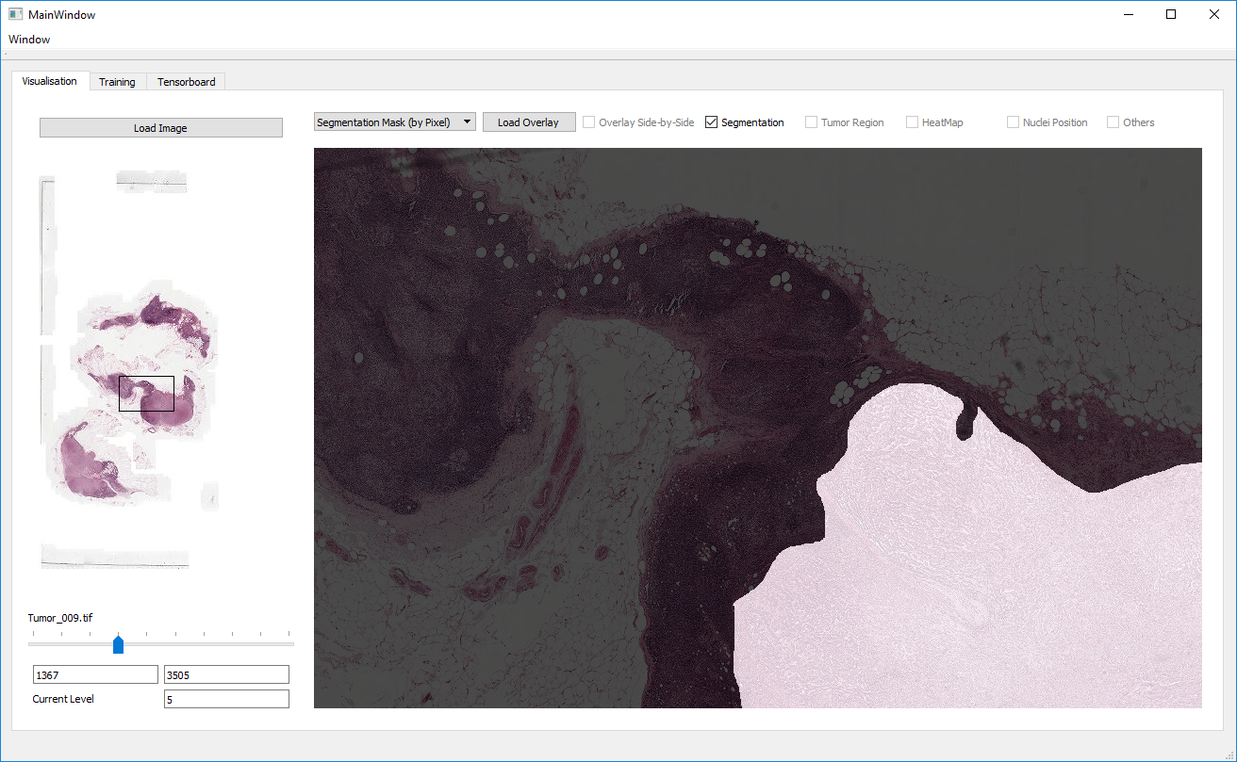
Interface- Segmentation Mask

Slide 6
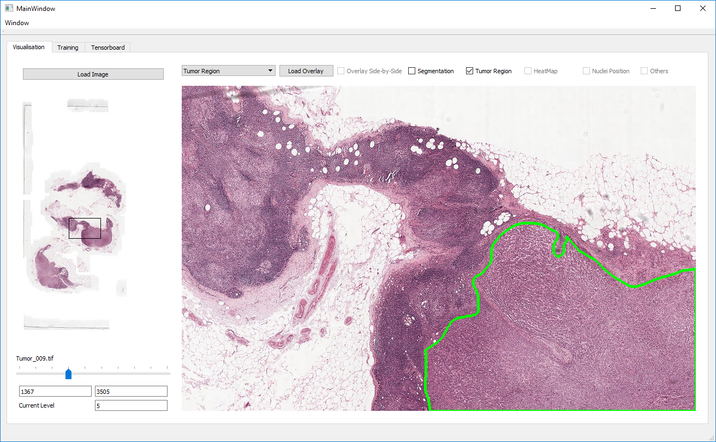
Interface- Tumor Region

Slide 7
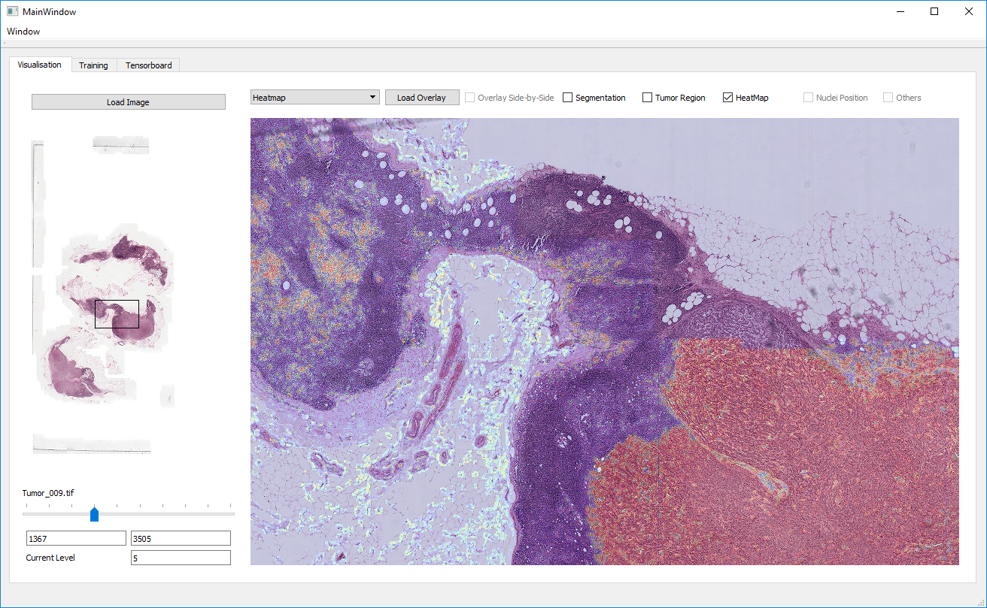
Interface- Heatmap

Slide 8
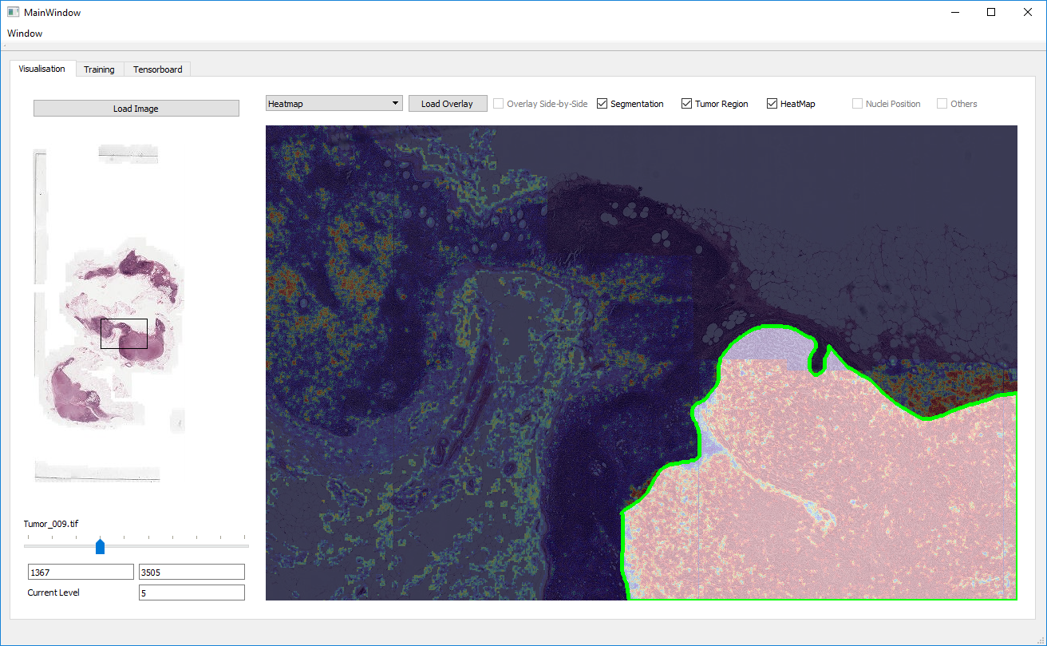
Interface- All at Once

Slide 9
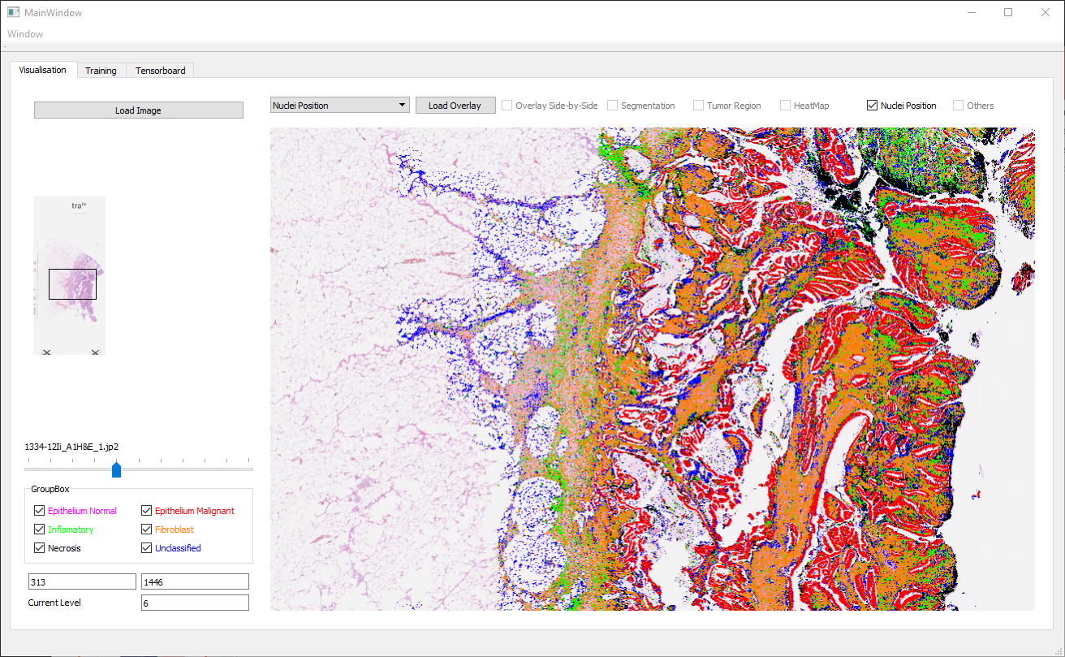
Interface- Nuclei Position

Slide 10
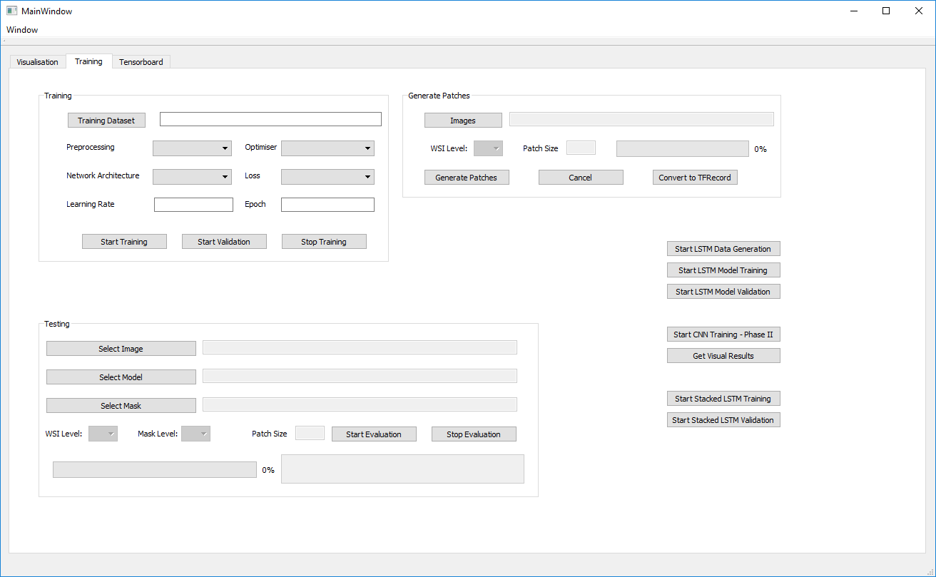
Interface- Training tab

Slide 11
Training Module – Phase I
Specify
Patches -> TFRecords
Phase 2
Image Directory
Validation Split
Number of shards
Coordinates Path
Actual Training
Image Directory
WSI Level
Patch Size
outputs
outputs
Directory with folders for each classes along with patches
List of coordinates at chosen WSI level
Directory of TFRecords containing train and validation

Slide 12
Training Module – Phase II
Specify
Training on a different thread
Validation
Dataset directory with TFRecords
Network
Preprocessor
Log Directory
Batch Size, No. of Classes, etc.
Read model for checkpoints
Generate results
Log them for viewing with TensorBoard
outputs
Directory with logs for viewing with TensorBoard
Model checkpoints at different epochs

Slide 13
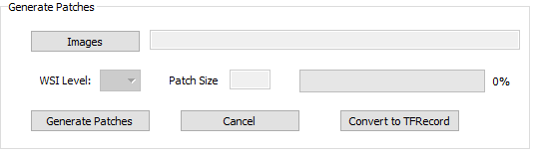
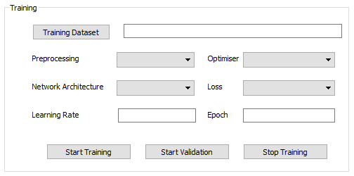
Train Module

Slide 14
Test Module
Present:
Specify
Output generation on a different thread
Output at different scales
TF Checkpoint
WSI Image
Start a new thread
Generate Patches
Preprocess
Feed to model
Save output patches
Combine output patches
Save at different scales

Slide 15
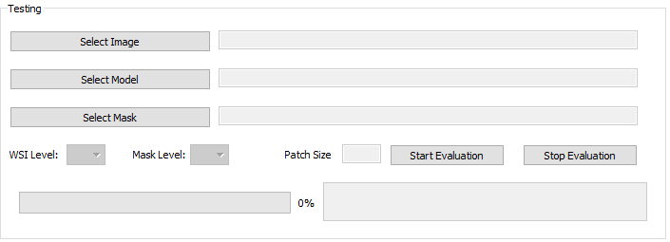
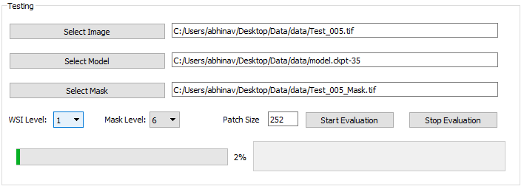
Test Module - UI

Slide 16
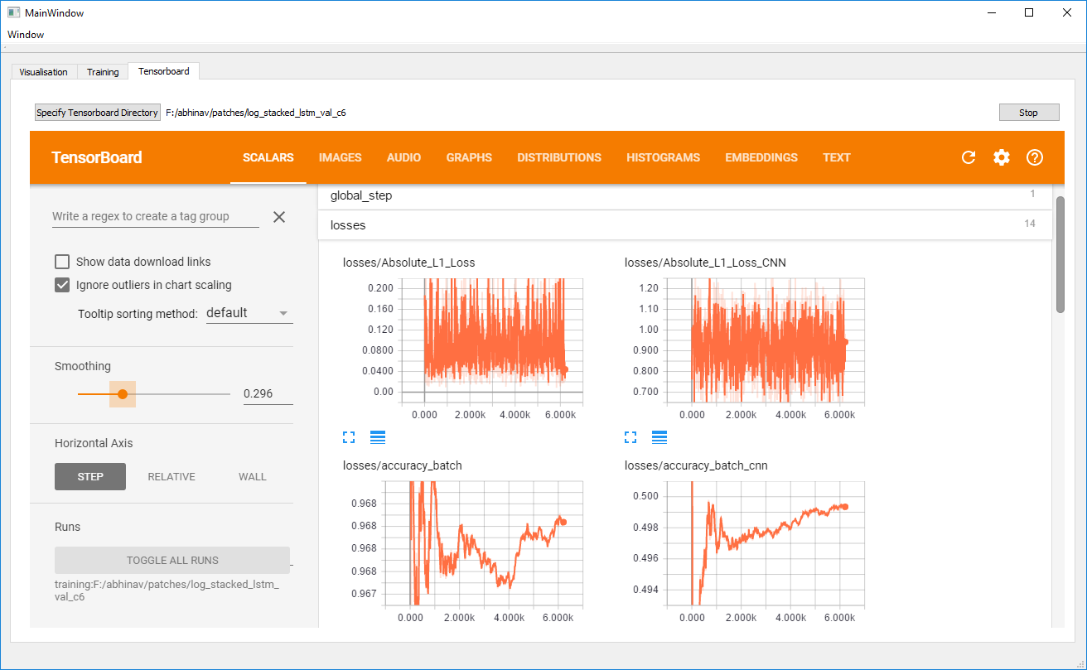
Tensorboard Visualization

Slide 17
Segmentation
Problem Discussion
Proposed approach
Dataset and Experiments
Results

Slide 18
Problem
Segmentation ~ Patch Classification
Pixel wise granularity not required for WSI
Neural Network
Whole Slide Image
Segmentation Mask

Slide 19
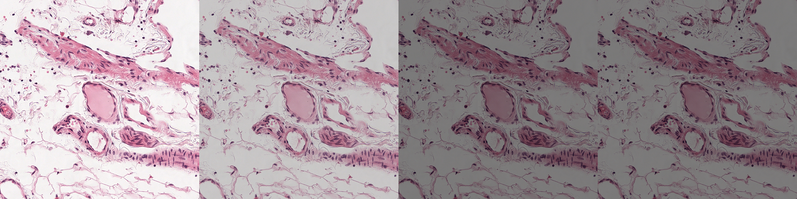
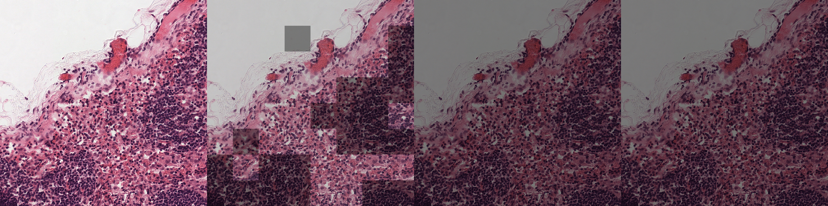
Problem
Segmentation ~ Patch Classification
Pixel wise granularity not required for WSI
WSI split into patches and trained
Neural Network
Whole Slide Image
Segmentation Mask

Slide 20
Problem
Segmentation ~ Patch Classification
Pixel wise granularity not required for WSI
WSI split into patches and trained
Context information lost
Idea: Model context using CNNs/LSTMs
Representation-Aggregation Networks (RAN)

Slide 21
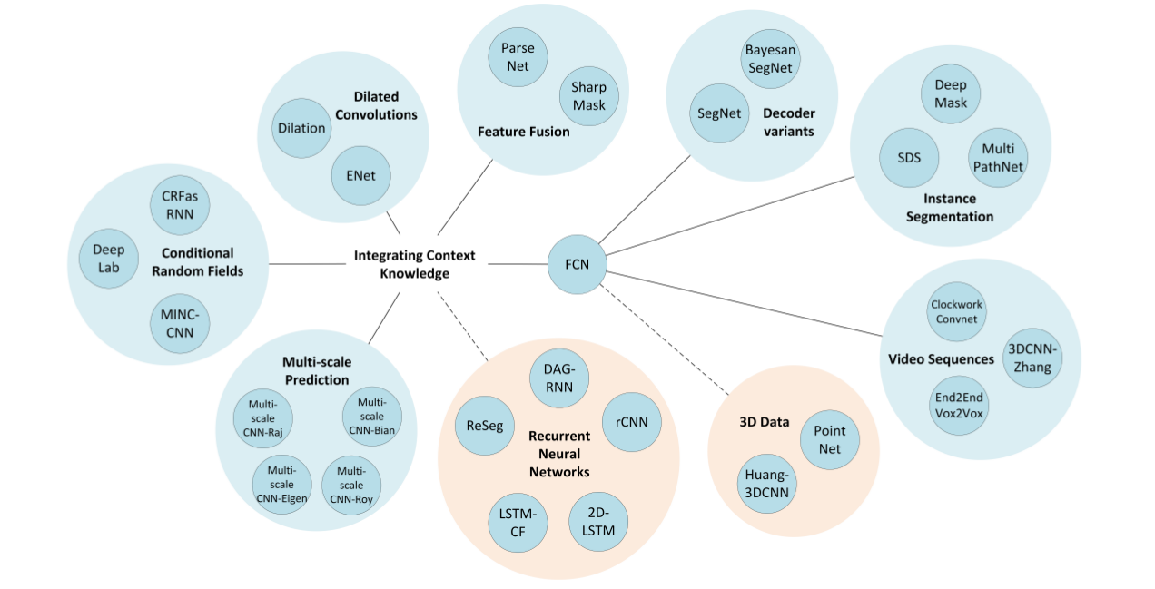
Segmentation Techniques
A Review on Deep Learning Techniques Applied to Semantic Segmentation
Garcia-Garcia et.al, Submitted to TPAMI, April 2017

Slide 22
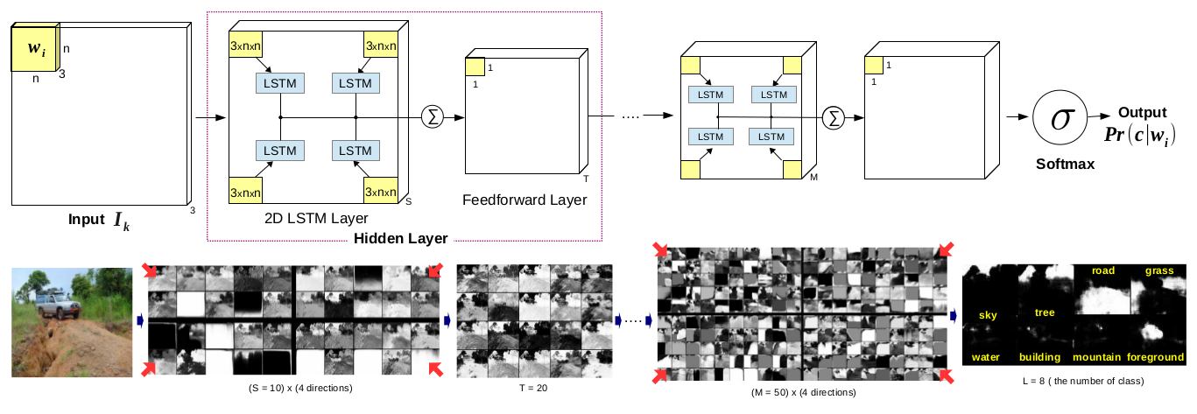
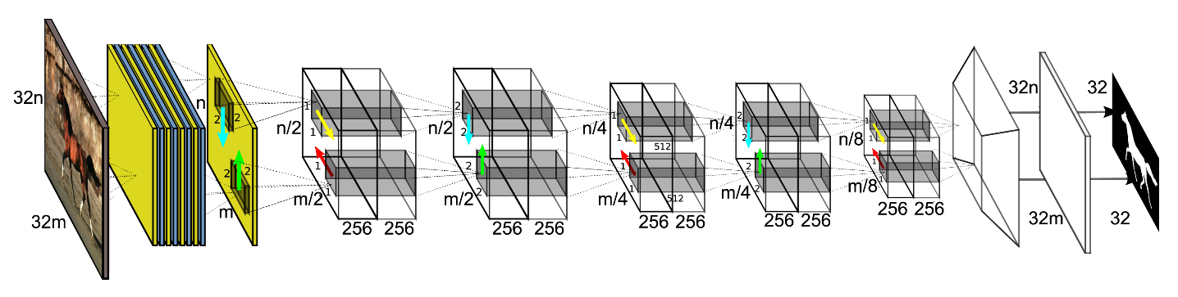
Related Work
1. 2D LSTM
2. ReSeg
1. Scene Labelling with LSTM, Byeon et.al., CVPR 2015
2. ReSeg, Visin et.al. CVPR Deep Vision workshop 2016

Slide 23
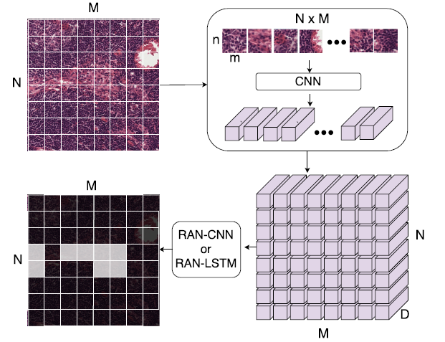
Proposed Model
A large region from WSI which consist of NM patches.
A CNN (eg. AlexNet, GoogLeNet, etc) encodes each patch independently into high dimensional features.
Rearranged features into 2D-grid format.
Overlay of prediction from RANs on the input. Both light and dark patches represent different classes

Slide 24
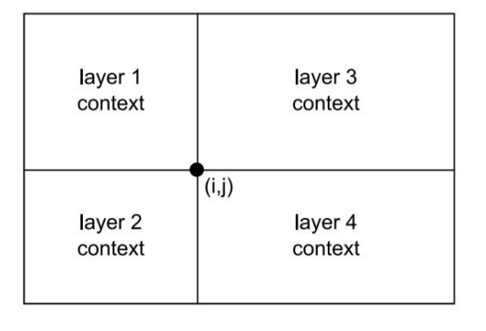
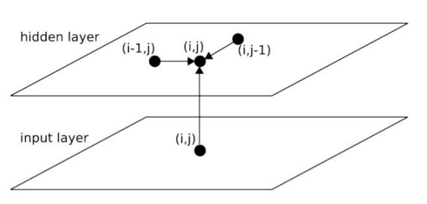
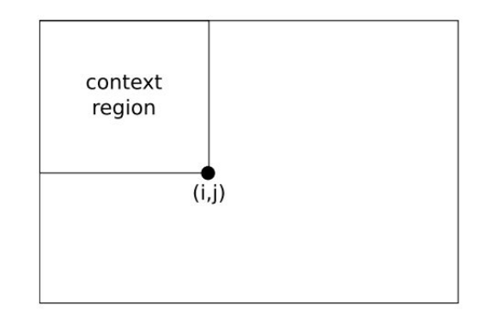
2D LSTM: Overview
Standard RNNs are 1-dimensional, thus unsuitable for 2D data (images)
Multi-Dimensional RNNs: Graves, Fernandez, Schmidhuber, 2007

Slide 25
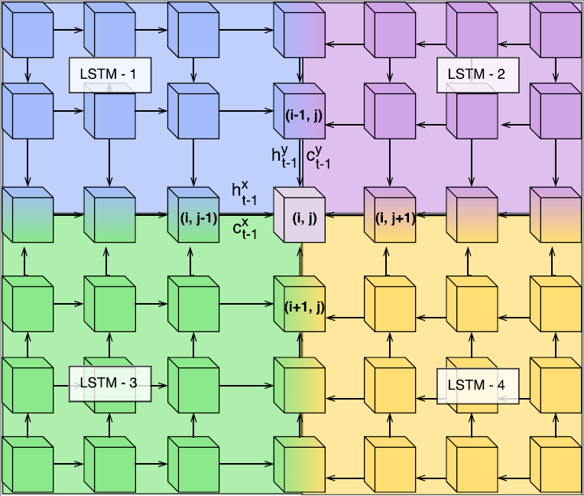
2D LSTM: Overview
Hidden states {h^x_{t-1}, cell states {c^x_{t-1} are used for prediction at (i,j) by LSTM-1.
Similarly, outputs from LSTM-{1,2,3,4} denoted by blue, pink, yellow and green are averaged for prediction at each cell (i,j) by using context from adjacent patches.

Slide 26
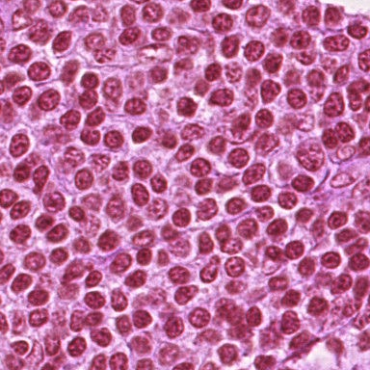
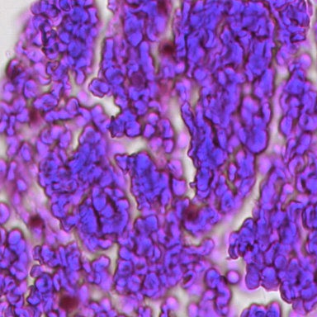
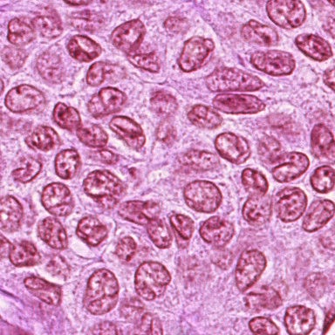
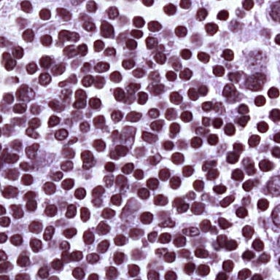
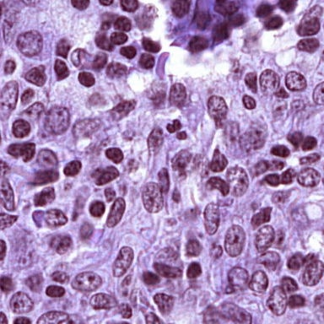
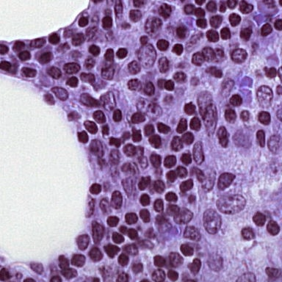
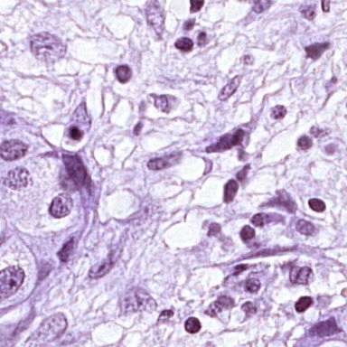
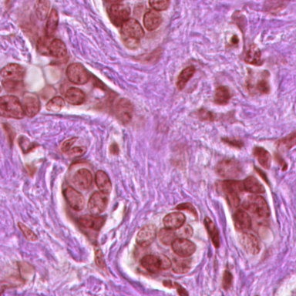
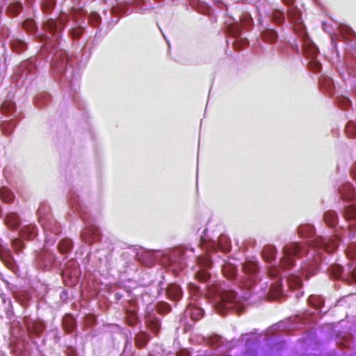
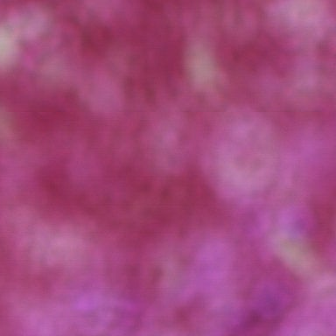
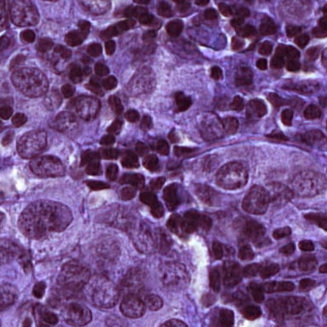
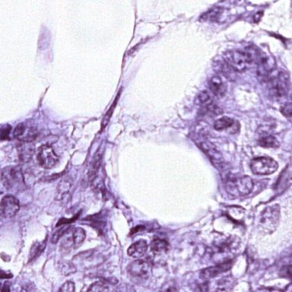
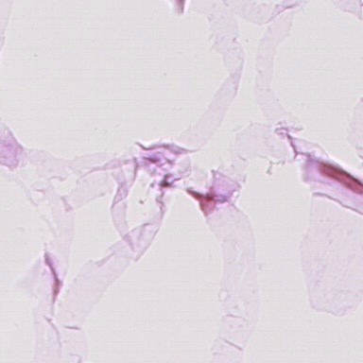
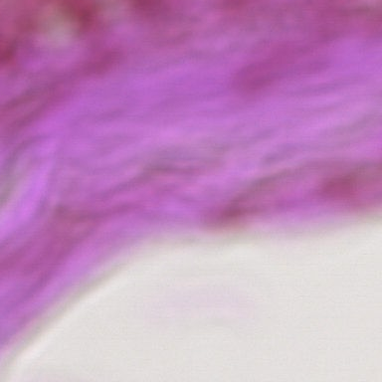
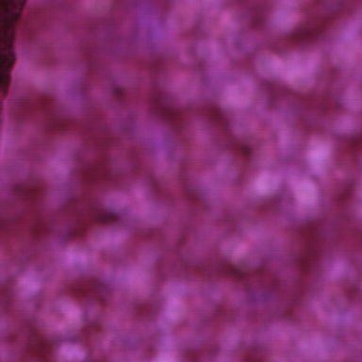
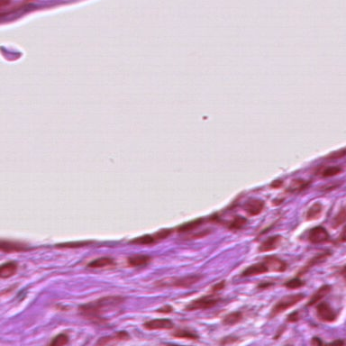
Dataset I – Camelyon (for Alexnet pre-training)
Non-Tumor Patches
Tumor Patches
Tumor: 123k patches, Non-Tumor: 143k
Training: 188k, Validation: 79k (80-20 WSI split)

Slide 27
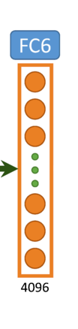
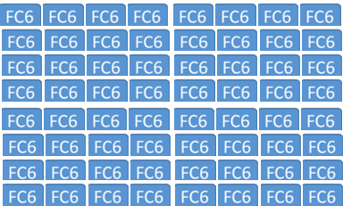
Dataset II – Camelyon (patches along with context)
Features: FC6 features for a context patch of size 8*8
Each FC6 features corresponds to 224*224
Thus, looking at images of size 1792*1792 (224*8) at 40x resolution
Training: ~190k
Validation: 99k

Slide 28
Data Imbalance
Makes training inefficient, networks start classifying majority patches as non-tumor
For larger context patches:
Only 10% contain at least 1 smaller tumor patch
Only 6% tumorous when calculated on the small patches level

Slide 29
Addressing Data Imbalance
Resampling Data:
Training only on 28k large context patches
With equal number of tumor, and non-tumor small patches

Slide 30
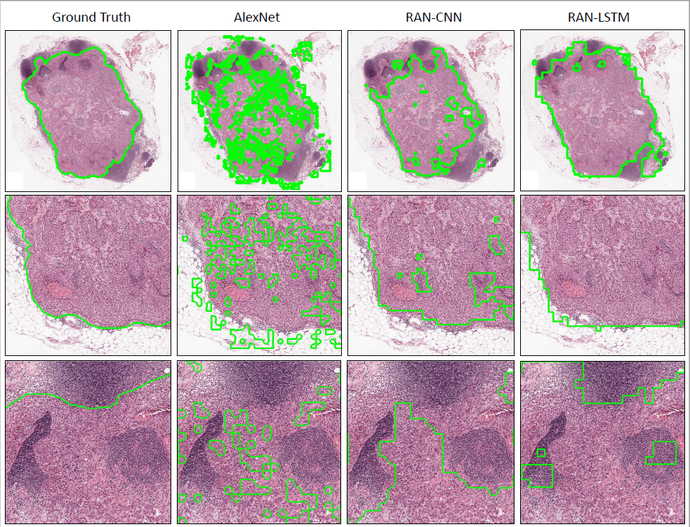
Visual Results
Visual comparison of approaches along with ground truth
Green color indicates the boundaries of a continuous tumor region.
AlexNet outputs several discontinuous blobs, which is considerably improved by RANs

Slide 31
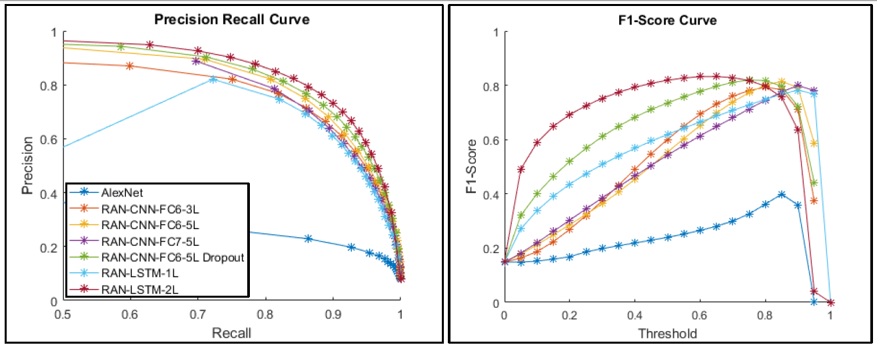
Quantitative Results
Precision-Recall and F1-score curves of different experiments of RAN-CNN along with AlexNet and RAN-LSTM.

Slide 32
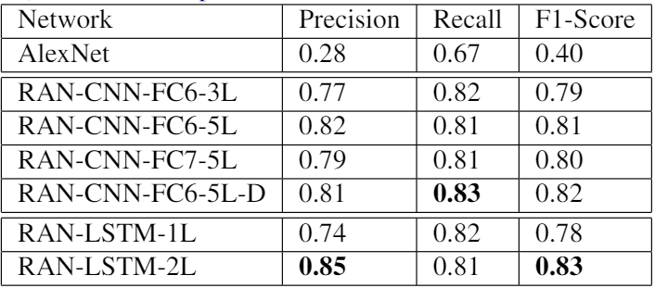
Quantitative Results
RANs significantly outperform traditional CNN approach
RAN-LSTM-2L achieves the best F1-score of 0.83

Slide 33
Thank you !!

